Slide 1
Research Techniques
1-Preparation starting material and drying solvent
solid , liquid
standard reagents
3- Drying methods
Rotary evaporator
Freeze drying
3- Chromatography
Paper chromatography
Thin layer chromatography
Column chromatography
GC , HPLC , LC

Slide 2
4-Spectroscopic technique
FTIR ( liquid , gas , solid )
Uv- Visible ( identification , kinetic , concentration )
5- Mass spectra
Hard ionization ( EI)
soft Ionization (ESI)
GC-Mass , HPLC- Mass
Direct insertion probe

Slide 3
Preparation starting material
Solid sample
Test ( melting point , TLC )
Purification ( recrystalization , distillation under vacuum )
Liquid sample
test ( boiling point , TLC )
distillation , extraction ,
Solvents
drying agents
removing water from solvent

Slide 4
Drying reagents
Commonly used drying are calcium chloride (CaCl₂), sodium sulfate (Na₂SO₄) calcium sulfate (CaSO₄, also known as Drierite) and magnesium sulfate (MgSO₄), all in their anhydrous
Calcium chloride (n=6) is a very good drying agent for a broad variety of solvents but is generally not compatible with hydroxy (alcohol, phenol), amino (amine, amide) and carbonyl (acid, ketone, ester)
Magnesium sulfate (n=7) is a slightly acidic drying agent. It works well in solvents like diethyl ether, but not as well for ethyl acetate. It is a fast drying agent, in part because it comes as a fine powder with a large surface area.
Sodium sulfate (n=10) has a very high capacity and is mainly used for very wet solutions
Molecular sieves are alumino silicates with a three-dimensional network with different pore sizes (3-5 Å). They have to be activated prior use and also can be regenerated at higher temperatures (~180 ºC - 260 ºC, 1-2 hours).

Slide 5
Specific solvents
THF (Tetrahydrofuran): distilled from sodium benzophenone ketyl. Add sodium wire and benzophenone to a volume of THF (pre-dried over calcium hydride or 4A molecular sieves), heat at reflux/under nitrogen for several hours until the solvent turns deep blue in colour. This indicates the solvent is dry, and you can distill off the volume you require. With time (weeks-maybe months if used correctly) the still will turn orange, this indicates that it is time to make a new one!
DCM (Dichloromethane): pre-dry over calcium hydride, then distil over calcium hydride... unfortunately no colorimetric indicator to tell you when the solvent is dry.
MeCN (Acetonitrile): pre-dry by shaking with type 4A molecular sieves, the distil over calcium hydride. Dried acetonitrile can be stored over 4A molecular sieves.
Methanol: For most purposes, drying over 3A molecular sieves overnight followed by distillation is sufficient. Alternatively, the methanol can be dried from magnesium methoxide. Magnesium turnings (5 g) and iodine (0.5 g) are refluxed in a small (50-100 mL) quantity of dry methanol (from a previous batch) until all of the magnesium has reacted. The mixture is diluted (up to 1 L) with reagent grade methanol, refluxed for 2-3 hours then distilled under nitrogen.
DMF (N,N-dimethylformamide): Decomposes slowly at room temperature and more rapidly at reflux, releasing dimethylamine and carbon monoxide. This decomposition is catalysed by acidic and basic impurities, and standing DMF for several hours at room temperature with basic drying agents such as calcium hydride or sodium hydroxide leads to noticeable decomposition. Dry DMF can be prepared by drying overnight over barium oxide or 4A molecular sieves, followed by decantation of the drying agent and vacuum distillation (~20 mmHg is a sufficient vacuum to lower the boiling point over DMF to a reasonable value). Dry DMF can be stored over 4A molecular sieves.

Slide 6
Drying reagents
Class of Compounds | Recommended Drying Agent
Alkane, alkyl halides | MgSO₄, CaCl₂, CaSO₄, H₂SO₄, P₄O₁₀
Aromatic hydrocarbons, ethers | MgSO₄, CaCl₂, CaSO₄, P₄O₁₀, Na-metal
Aldehydes, ketones, esters | Na₂SO₄, MgSO₄, K₂CO₃, CaSO₄
Alcohols | MgSO₄, K₂CO₃, CaSO₄, CaO, BaO
Amines | KOH, K₂CO₃
Acidic compounds | Na₂SO₄, MgSO₄, CaSO₄
The drying agent is only working if it is still anhydrous

Slide 7
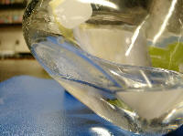
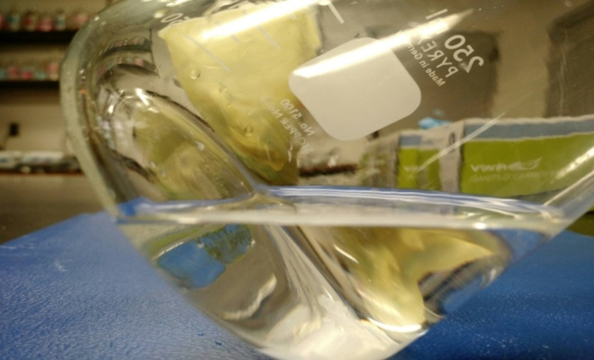
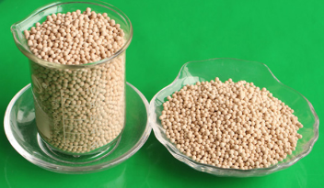
After Drying
Wet solution

Slide 8
Drying methods
Type of materials sources
1- Extraction materials ( natural compounds )
light oil
Terpene oil
alkaloids
steroids
Falvonoids
phenol and poly phenol
gum ( resin )
2- preparation materials ( products of organic or inorganic reaction )

Slide 9
Many criteria affect the choice of a drying method during recovery efforts. Among these are:
* Ability to appropriately stabilize the environment in order to begin recovery efforts
* Scale of damage and number of items affected
Best drying method depending on type, format, and volume of material
various drying methods
Air drying
Rotary evaporate
* Freezer Drying
* Dehumidification drying

Slide 10
Air drying
Air-drying must take place in a cool, dry place
Air-drying rooms should have the capacity to maintain a constant relative humidity of 25 -35% (or at least below 50%) and a temperature of between 50 and 65 degrees F
Air circulation should be constant, and may be aided by the use of portable fans
Dehumidifiers may be used but must be maintained daily and will only work in smaller, enclosed spaces
Air-dry materials indoors if possible

Slide 11
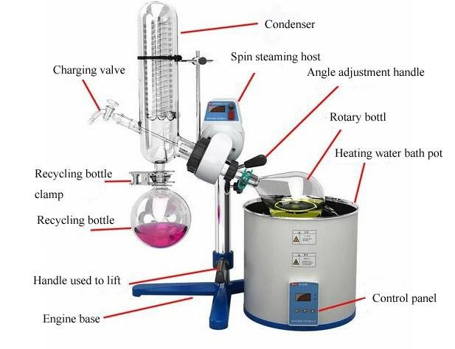
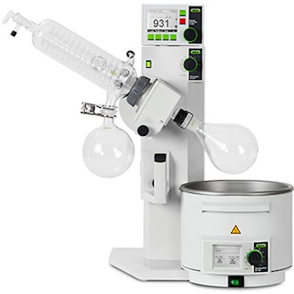
Rotary evaporator

Slide 12
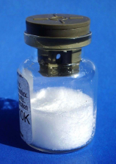
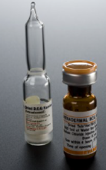
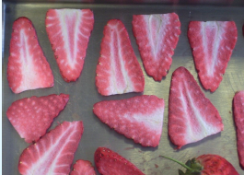
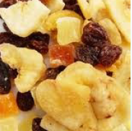
Freeze drying (Lyophilization )
Freeze drying is a complex operation where the solvent (usually water) is removed from the product by sublimation. Sublimation occurs when a frozen liquid goes directly to the gaseous state without passing through the liquid phase. This direct phase transfer “ice - water vapor” is a function of pressure and ice temperature which can be delineated by the phase diagram of water:

Slide 13
Lyophilization or freeze drying is a process in which water is frozen, followed by its removal from the sample.
initially by sublimation (primary drying) and then by desorption (secondary drying).
Freezedrying is a process of drying in which water is sublimed from the product after it is frozen . It is a drying process applicable to manufacture of certain pharmaceuticals and biologicals that are
thermolabile or otherwise unstable in aqueous solutions for prolonged storage periods, but that are stable in the dry state. The term “lyophilization” describes a process to produce a product that
“loves the dry state”

Slide 14
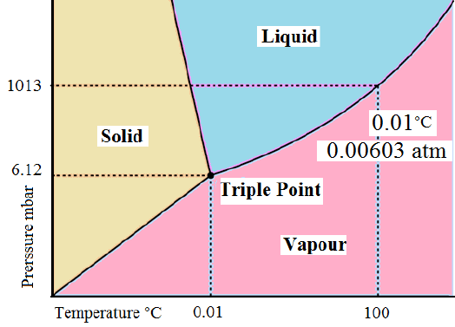
Lyophilization is performed at temperature and
pressure conditions below the triple point, to
enable sublimation of ice. The entire process is
performed at low temperature and pressure, hence
is suited for drying of thermolabile compounds.
Steps involved in lyophilization start from sample
preparation followed by freezing, primary drying
and secondary drying, to obtain the final dried
product with desired moisture content .The
concentration gradient of water vapor between the
drying front and condenser is the driving force for
removal of water during lyophilization

Slide 15
APPLICATIONS
Pharmaceutical and biotechnology
Food Industry
Technological Industry
In chemical synthesis, products are often freeze dried to make them more stable, or easier to dissolve in water for subsequent use. In bio separations, freeze-drying can be used also as a late-stage purification procedure, because it can effectively remove solvents. Furthermore, it is capable of concentrating substances with low molecular weights that are too small to be removed by a filtration membrane

